Slide 1
Scientific paper writing
Avadhani Bindu

Slide 2
Scientific Writing
A scientific paper is a manuscript that represents an original work of scientific research or study.
Three Golden rules-
Clarity – Research is unambiguous and free of irrelevant conjecture or detail.
Simplicity – Language, sentence, and paragraph structure are easy to comprehend and follow without losing scientific credibility or authority.
Accuracy – Data, figures, tables, references, and citations are illustrated verifiably and honestly.
In science the credit goes to the man who convinces the world not the man to whom the idea first occurs
– Sir William Osler
A primary teaching practice-
Writing format,
Appropriateness of language and content,
Submission requirements,
Bibliographic styles, and much more.

Slide 3
Types of Articles
Types of Journal Articles
Research Notes
Letters
Supplementary Articles
Miniature Articles
Review articles
Research Papers

Slide 4

Writing the Manuscript
For that, you don’t have to be great to start but you have to start to be great
To improve writing
Read the manuscripts published in major journals of you area.
Practice, Practice and Practice
Get help from your peers and mentors

Slide 5
To make the manuscript readable and easy to understand

Slide 6
Writing Manuscript
Use present tense when referring to the work that has been already published.
Use past tense when referring to your own study
Use active voice as much as possible
Avoid lengthy and unfocussed points in the previous research works.
Cite peer – Reviewed Scientific literature scholarly articles are to referred.
Define abbreviations / specialized terms
Avoid long and complicated sentences.
General Rules

Slide 7
Writing Manuscript
What has to be avoided ?
Pretentious Language
Meaningless phrases and
Irrelevant material
Cluttering a paragraph
Repetition of sentences :
a) Results in discussion,
b) Discussion in results,
c) Repetition of Tables and Figures information in the text

Slide 8
Writing Manuscript
Record your results
Make tables, draw graphs
Keep the summary of the results and any observation
Revise your readings
Plan the organization of the paper.
Try using reference managers to cite the references.
List the references for ease of referring.

Slide 9

Structure of the paper

Slide 10
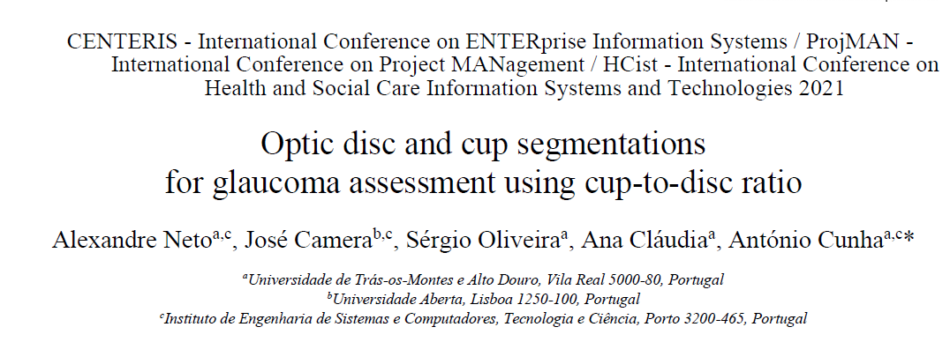
Title
Scientific Writing
Authors and Affiliations
Fewest possible words that adequately describe the content of the paper.
Indexing and abstracting of the paper depends on the accuracy of the title.
Note: Make it short and clear.
Should be followed as per the template of the journal.
Keywords
Carefully give the words because they are used for indexing. So, mostly used words like algorithm names/methods etc can be given .

Slide 11
Abstract
Complete- major parts of the project
Concise- should not contains more wordiness or unnecessary info
Clear – It is readable, well organized and too long
Cohesive- It flows smoothly between the parts
A condensed version of the full article.
Precise statements of major elements like purpose, methods, and findings of the project.
4 C’s in abstract

Slide 12
How to write a good introduction ?
It should present the nature and scope of the problem
Review the pertinent Literature
State the method of investigation
State the principal results of investigation

Slide 13
Materials and Methods
Full details of the experiment that can be reproducible.
Organize the methods under sub-headings with related methods described together
Write in the part tense.
Few of them organize the materials as “Preliminaries” and “Methods” as individual section.
Also use mathematical equations and cite them at appropriate place with equation number.
For the methods place the diagrammatic representation of architectures for better understanding. (Image speaks better than thousands of words)

Slide 14
Results and Discussion
Results | Discussion
Include experimental data but not the interpretation. | Explain any surprising/ unexpected or inconclusive results.
Project the statistical analysis if applicable. | List out the major findings of the study.
Sequence matters when data is presented. | Interpret and explain the findings effectively.
Include texts, figures and tables. (Stress major points through text) | Also mention if any limitations
Avoid the incomplete evidences (speculations) and repetition of methods described in M&M section. | Relate to what others have done. (eg: comparative analysis)
1. It needs to be clearly and imply stated since it constitutes new knowledge.
2. Never have a table or figure that has not mentioned/referred in the text.
3. All tables, figures must be accompanied by the textual presentation of main findings.
Usage of Figures and Tables
Evidence – data supports findings
Emphasis- to highlight the key points
Efficiency- precise data that cannot be in text

Slide 15
For good Discussion
Restate the main question with the answer
Provide supporting evidence by restating the results briefly
Focus on what results mean. Do not repeat the values and add the new results

Slide 16
Scientific Writing Contd…
Acknowledgements:
Note: Do not write I wish to thank/ I wish …..
Conclusion and Future enhancements: (should not exceed more than
200/ 300 words )
Explain the main findings of the work.
Describe why your findings are significant.
Provide the future enhancements/ limitations of your work.
Any significant technical help that you have received from any person in lab or elsewhere
Any financial assistance received from outside (Grants/ contracts/ Fellowships)
If received any material like datasets/ special equipment

Slide 17
References
Referencing is a standardized way of acknowledging the sources of information or ideas that you have used in your document.
A list of all references must be cited in text.
Must not be included with URLs, dataset links etc.

Slide 18
Summary of Scientific writing
Assess your work: Decide what, when and where to publish
Obtain and read the instructions to authors of the chosen journal
Draft a working title and abstract
Decide on the basic form of the paper
Design tables and figures with titles and footnotes
Decide on the basic form of the paper
Form the outline of the paper
Write the preliminary draft to give the unity to the text.
Check the completeness of the references
Re-examine the structure of the paper
Check the illustrations and make final versions
Re-read the references cited and check appropriateness in citing them
Note: Finally
1. Ask for Criticism and thoroughly check the draft for any alterations.
2. Now frame the final title and abstract suitable for information retrieval

Slide 19
Summary Contd…
General
Check Grammatical errors, alignment of the text and spellings.
Tables
Must be in the format of table only.
Captions need to be placed at the top / as per the template of the paper.
Figures
Graphs should be presented with legends.
Equations format has to followed and numbering is must to cite them in the text.
Numbering for table/figure/ graphs/ equations must be sequential.
Figure captioning must be at the bottom of the figure only.

Slide 20

There is no way to get experience except through experience

